Slide 1
Chapter 13
Properties of Solutions

Slide 2
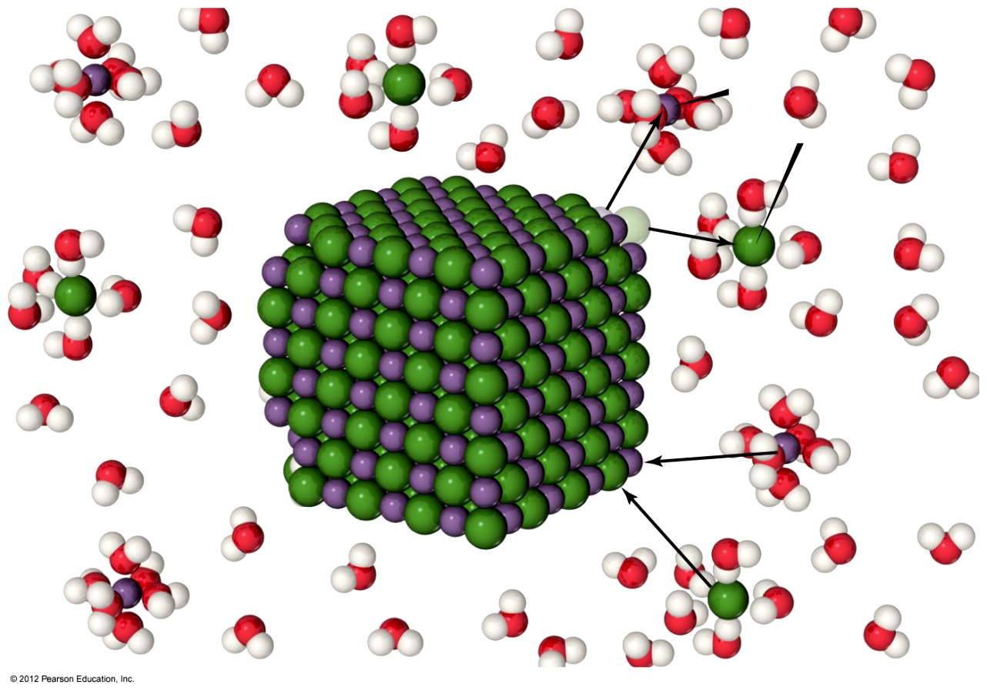
Solutions
溶液
Solutions are homogeneous mixtures of two or more pure substances.
In a solution, the solute is dispersed uniformly throughout the solvent.
溶质
溶剂

Slide 3
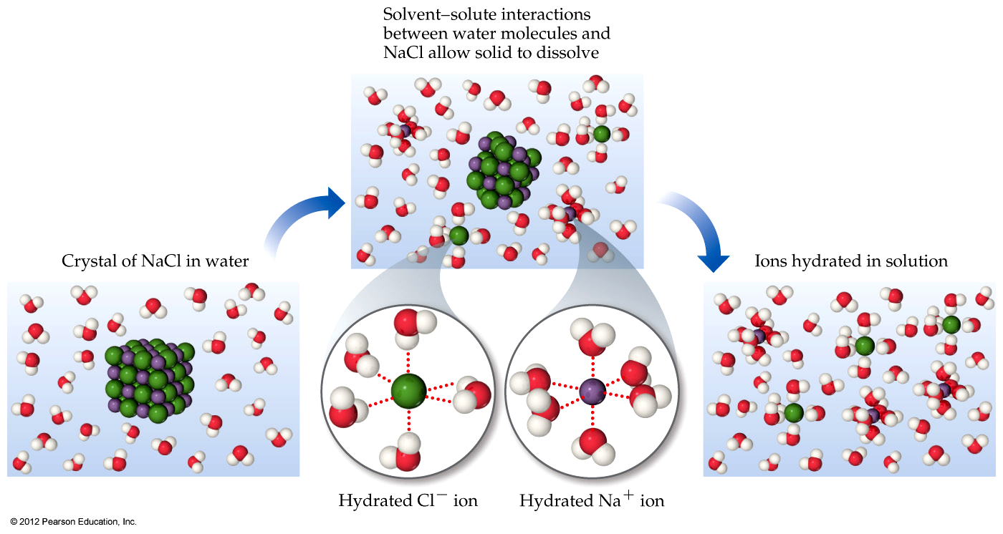
Solutions
The intermolecular forces between solute and solvent particles must be strong enough to compete with those between solute particles and those between solvent particles.

Slide 4
How Does a Solution Form?
As a solution forms, the solvent pulls solute particles apart and surrounds, or solvates, them.
使溶剂化

Slide 5
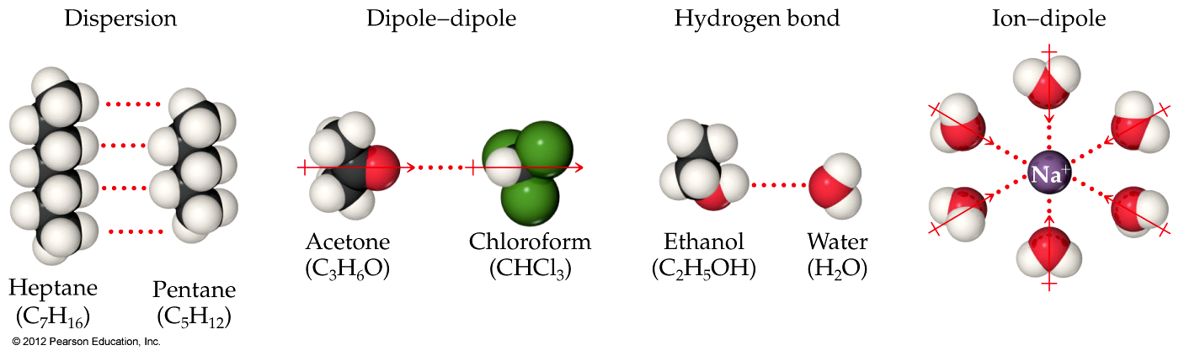
Intermolecular Interactions in Solutions

Slide 6
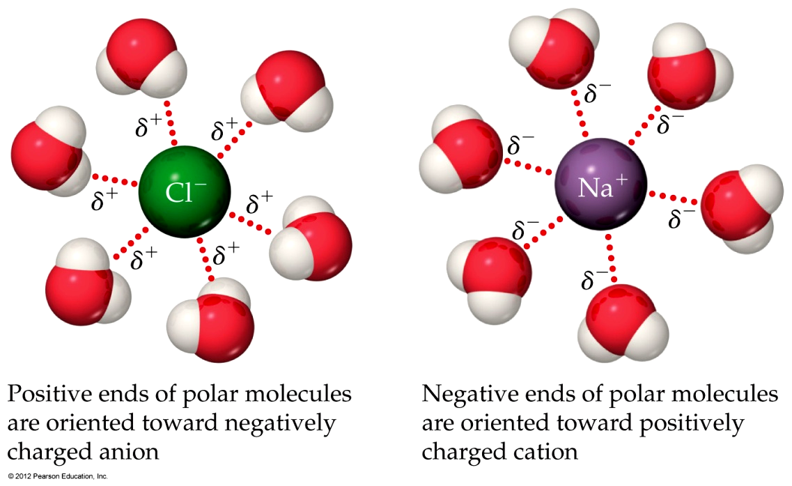
How Does a Solution Form?
If an ionic salt is soluble in water, it is because the ion–dipole interactions are strong enough to overcome the lattice energy of the salt crystal.

Slide 7

How Does a Solution Form?
Three kinds of intermolecular interactions are involved in solution formation:
Solute–solute interactions between solute particles must be overcome in order to disperse the solute particles through the solvent.
Solvent–solvent interactions between solvent particles must be overcome to make room for the solute particles in the solvent.
Solvent–solute interactions between solvent and solute particles occur as the particles mix.

Slide 8
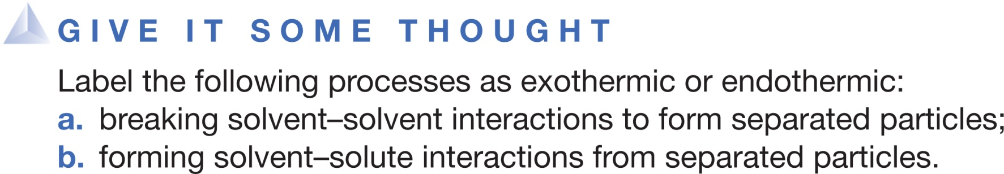

(a) (b)
Endothermic Endothermic
Endothermic Exothermic
Exothermic Endothermic
Exothermic Exothermic
Notes:
Answer: B

Slide 9
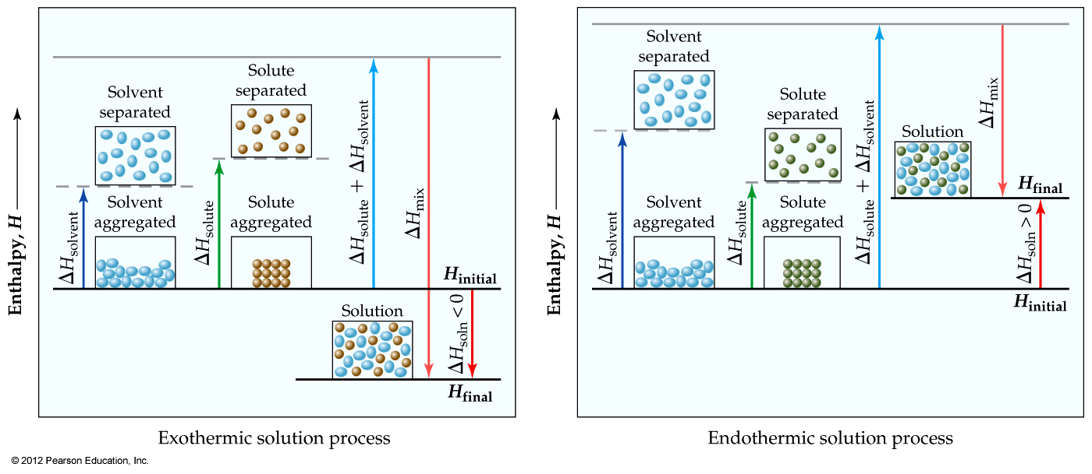
Energy Changes in Solution
Simply put, three processes affect the energetics of solution:
  Separation of solute particles,
  Separation of solvent particles,
  New interactions between solute and solvent.

Slide 10
Energy Changes in Solution
The enthalpy change of the overall process depends on ΔH for each of these steps.

Slide 11
Why Do Endothermic Processes Occur?
Things do not tend to occur spontaneously (i.e., without outside intervention) unless the energy of the system is lowered.

Slide 12
Why Do Endothermic Processes Occur?
Yet we know that in some processes, like the dissolution of NH₄NO₃ in water, heat is absorbed, not released.

Slide 13
Enthalpy Is Only Part of the Picture
The reason is that increasing the disorder or randomness (known as entropy) of a system tends to lower the energy of the system.
enthalpy
焓
entropy
熵

Slide 14
Enthalpy Is Only Part of the Picture
So even though enthalpy may increase, the overall energy of the system can still decrease if the system becomes more disordered.

Slide 15
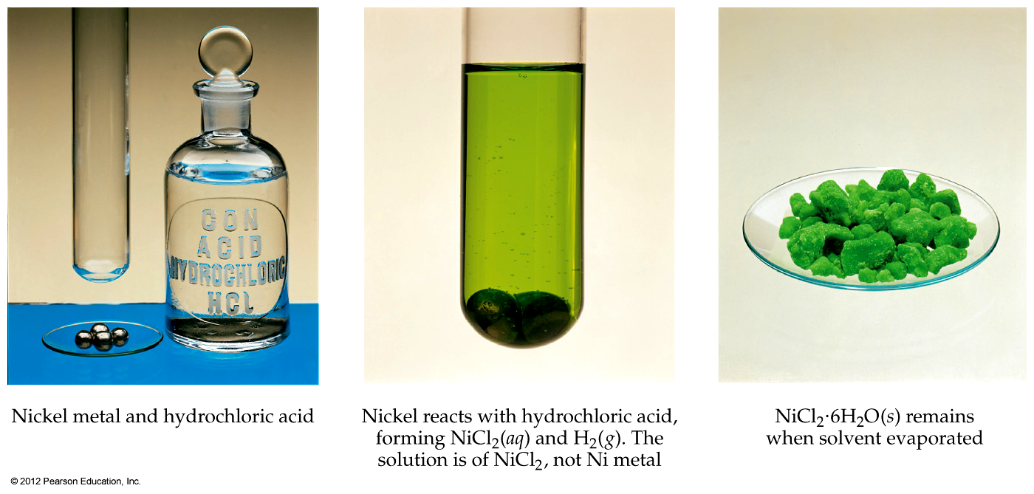
Student, Beware!
Just because a substance disappears when it comes in contact with a solvent, it doesn’t mean the substance dissolved. It may have reacted.

Slide 16
Student, Beware!
Dissolution is a physical change—you can get back the original solute by evaporating the solvent.
If you can’t get it back, the substance didn’t dissolve, it reacted.

Slide 17
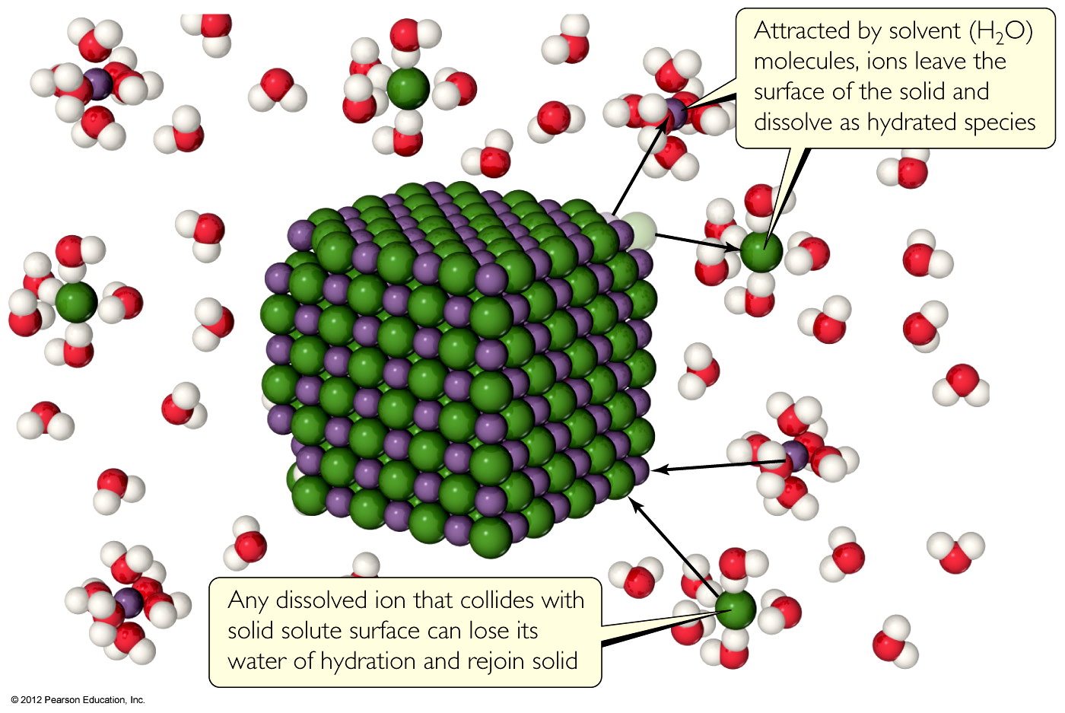
Types of Solutions
饱和的
Saturated
  In a saturated solution, the solvent holds as much solute as is possible at that temperature.
  Dissolved solute is in dynamic equilibrium with solid solute particles.

Slide 18
Types of Solutions
Unsaturated
  If a solution is unsaturated, less solute than can dissolve in the solvent at that temperature is dissolved in the solvent.

Slide 19
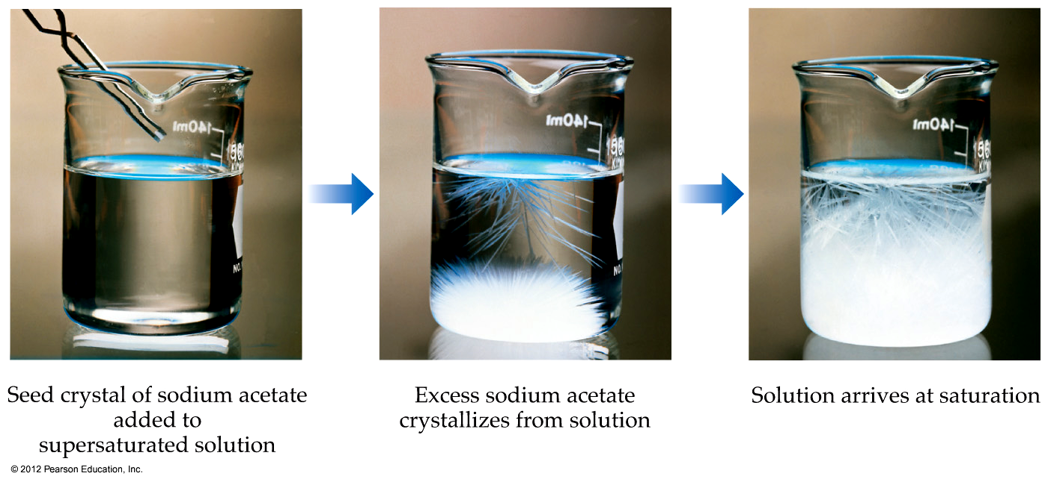
Types of Solutions
Supersaturated
  In supersaturated solutions, the solvent holds more solute than is normally possible at that temperature.
  These solutions are unstable; crystallization can usually be stimulated by adding a “seed crystal” or scratching the side of the flask.

Slide 20
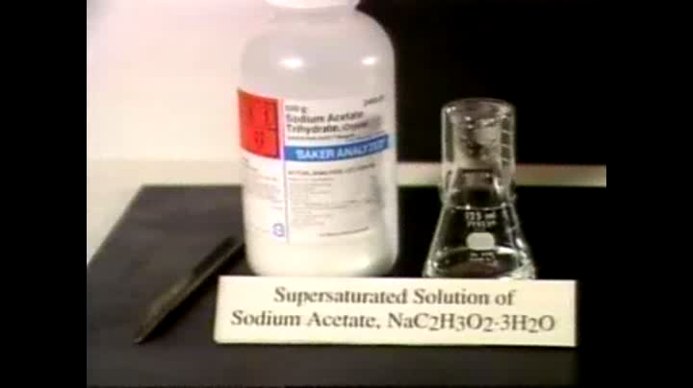
过饱和的
Crystallization of Supersaturated NaOAc

Slide 21
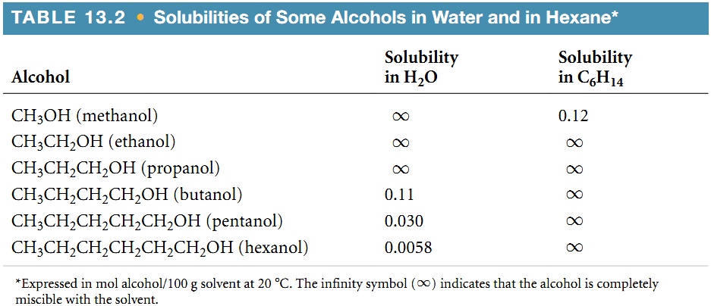
Factors Affecting Solubility
Chemists use the axiom “like dissolves like.”
  Polar substances tend to dissolve in polar solvents.
  Nonpolar substances tend to dissolve in nonpolar solvents.

Slide 22
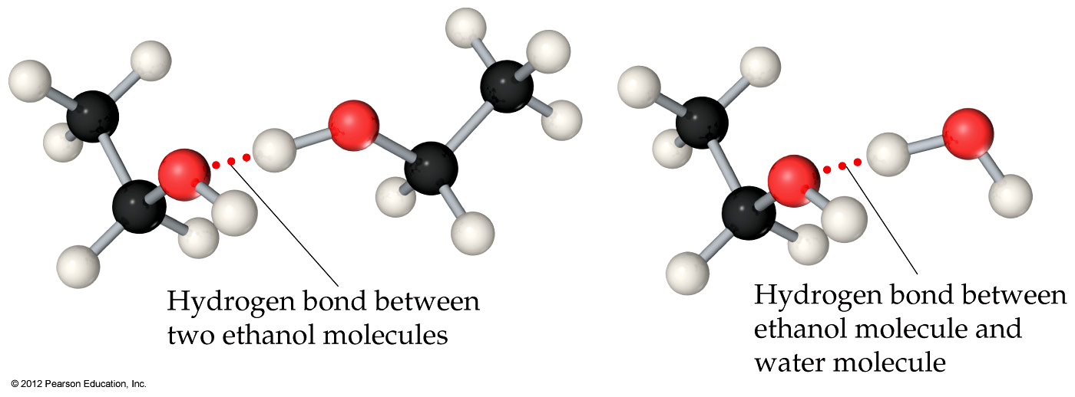
Factors Affecting Solubility
The more similar the intermolecular attractions, the more likely one substance is to be soluble in another.

Slide 23
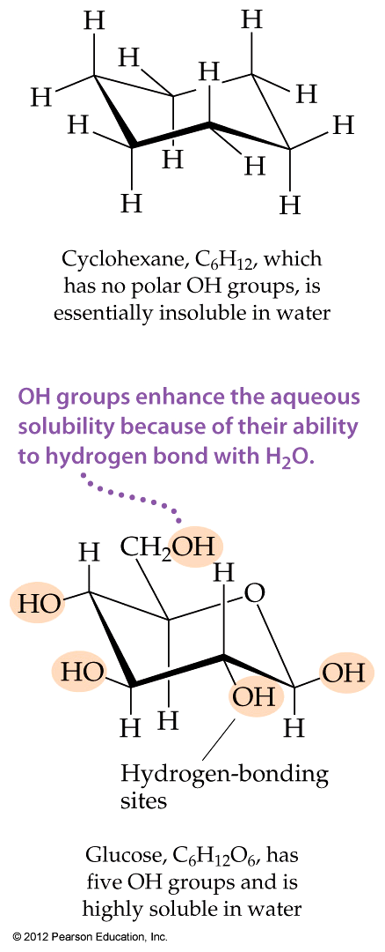
Factors Affecting Solubility
Glucose (which has hydrogen bonding) is very soluble in water, while cyclohexane (which only has dispersion forces) is not.

Slide 24
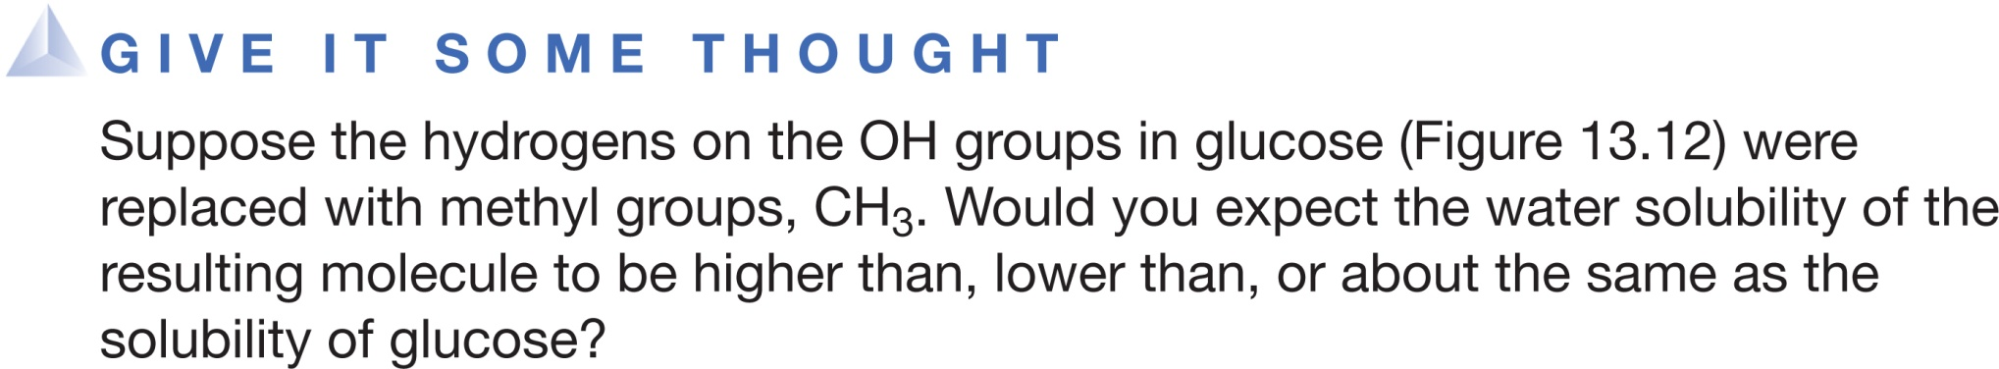
Higher solubility
Lower solubility
About the same solubility
Notes:
Answer: B

Slide 25
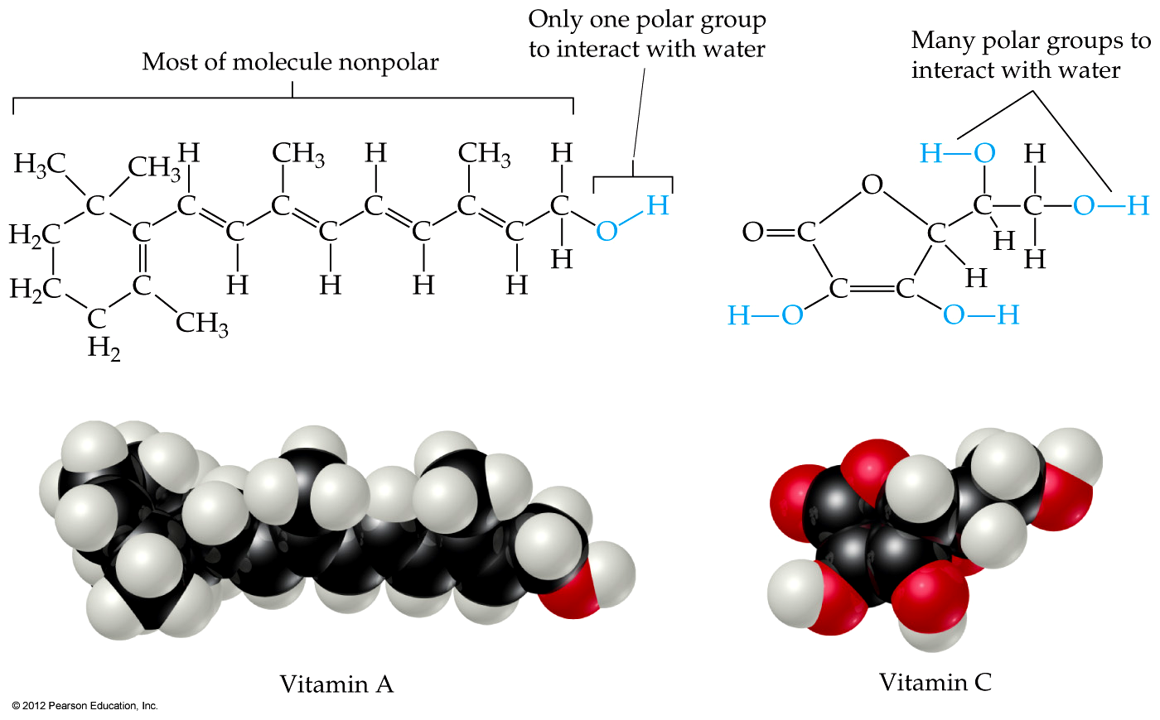
Factors Affecting Solubility
Vitamin A is soluble in nonpolar compounds (like fats).
Vitamin C is soluble in water.

Slide 26
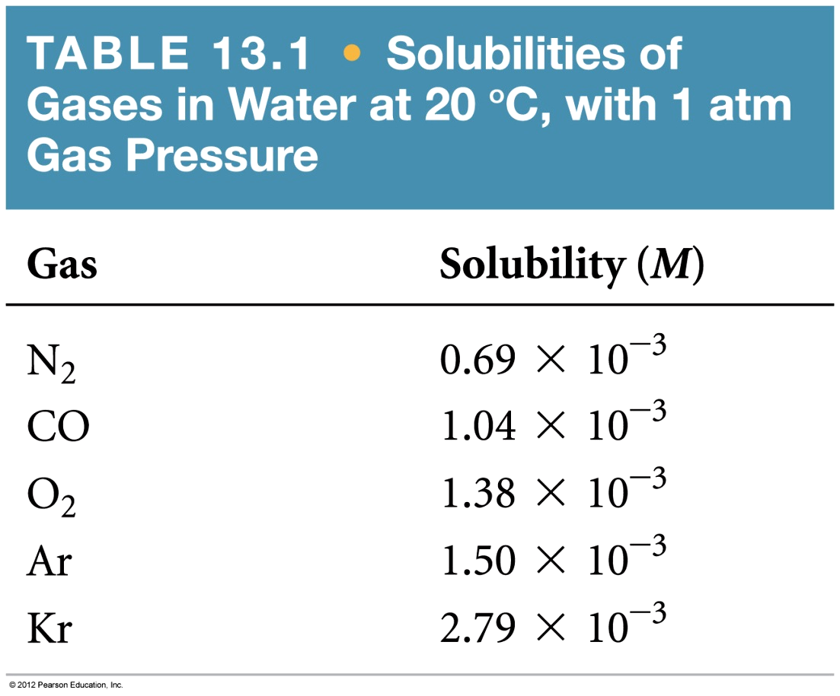
Gases in Solution
In general, the solubility of gases in water increases with increasing mass.
Larger molecules have stronger dispersion forces.

Slide 27
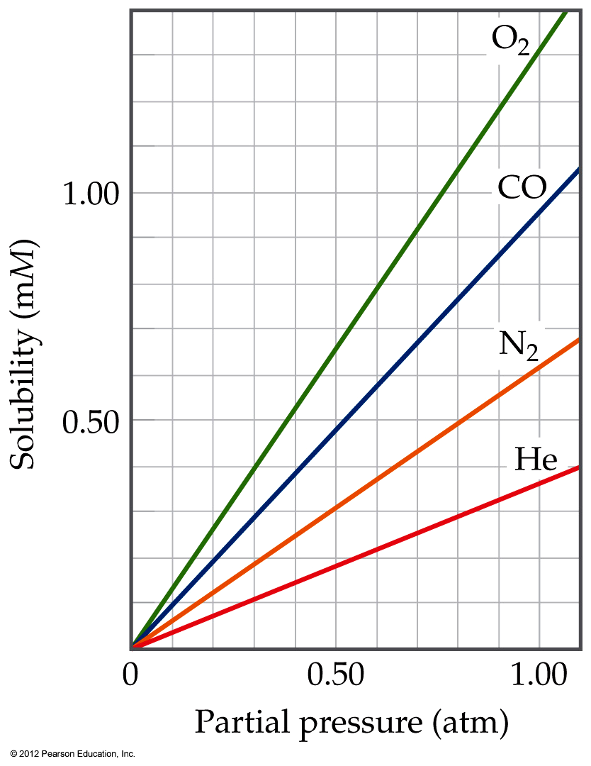
Gases in Solution
The solubility of liquids and solids does not change appreciably with pressure.
But the solubility of a gas in a liquid is directly proportional to its pressure.
Notes:
Start here 1/21/10--8:30 & 10

Slide 28
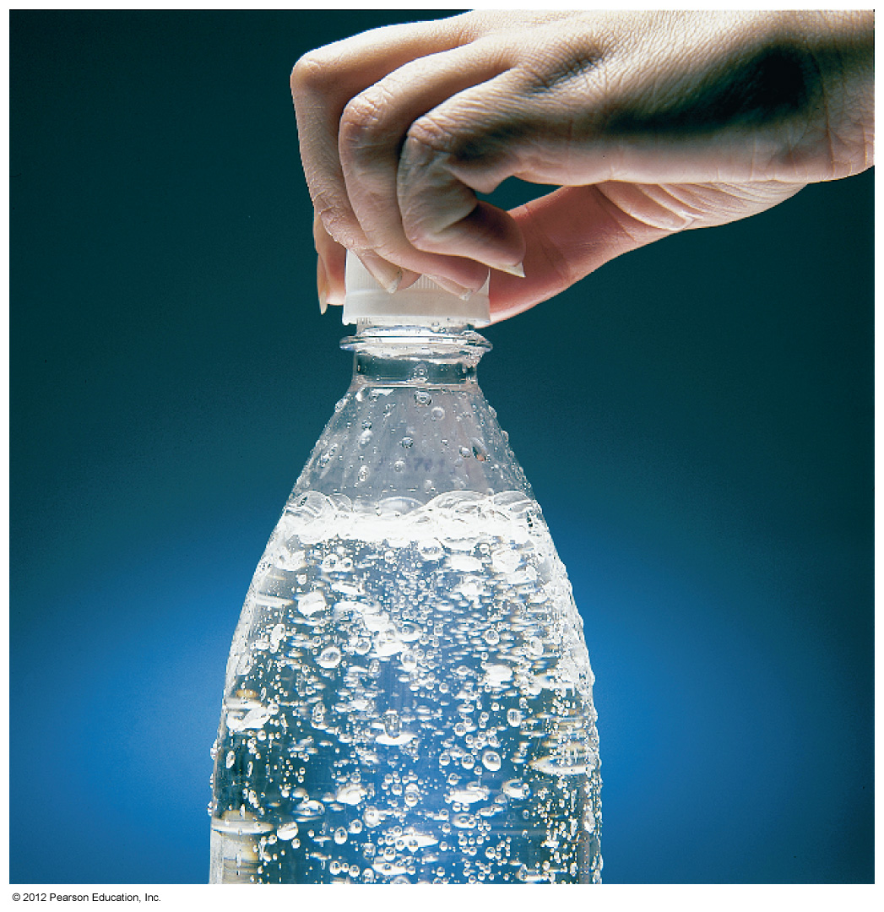
Henry’s Law
S_{g} = kP_{g}
where
S_{g} is the solubility of the gas,
k is the Henry’s Law constant for that gas in that solvent, and
P_{g} is the partial pressure of the gas above the liquid.

Slide 29
Exercise A Henry’s Law Calculation
Calculate the concentration of CO₂ in a soft drink that is bottled with a partial pressure of CO₂ of 4.0 atm over the liquid at 25 °C. The Henry’s law constant for CO₂ in water at this temperature is 3.4 × 10⁻² mol/L-atm.
Solution
Plan With the information given, we can use Henry’s law to calculate the solubility, S_{CO2}.
Solve
S_{CO2} = kP_{CO2} = (3.4 × 10⁻² mol/L-atm)(4.0 atm) = 0.14 mol/L = 0.14 M
Check The units are correct for solubility, and the answer has two significant figures consistent with both the partial pressure of CO₂ and the value of Henry’s constant.

Slide 30
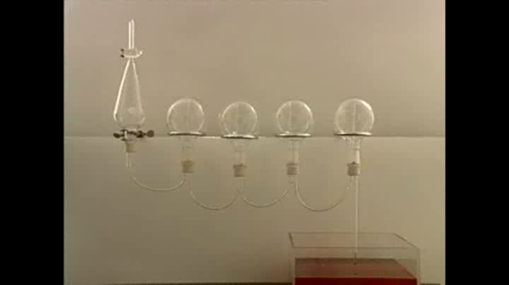
Ammonia in Water - Ammonia Fountains
Ammonia
Acetic acid

Slide 31
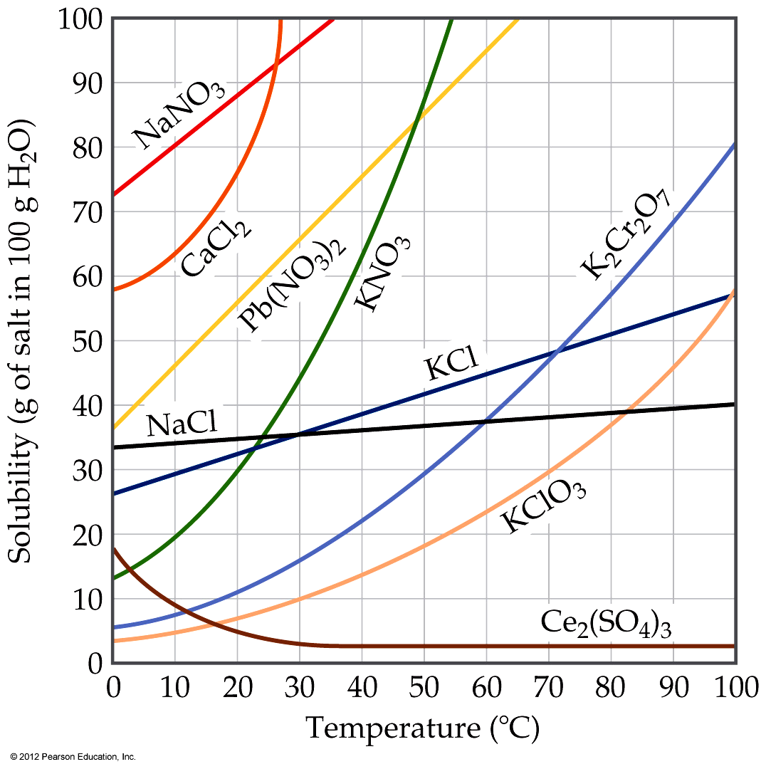
Temperature
Generally, the solubility of solid solutes in liquid solvents increases with increasing temperature.

Slide 32
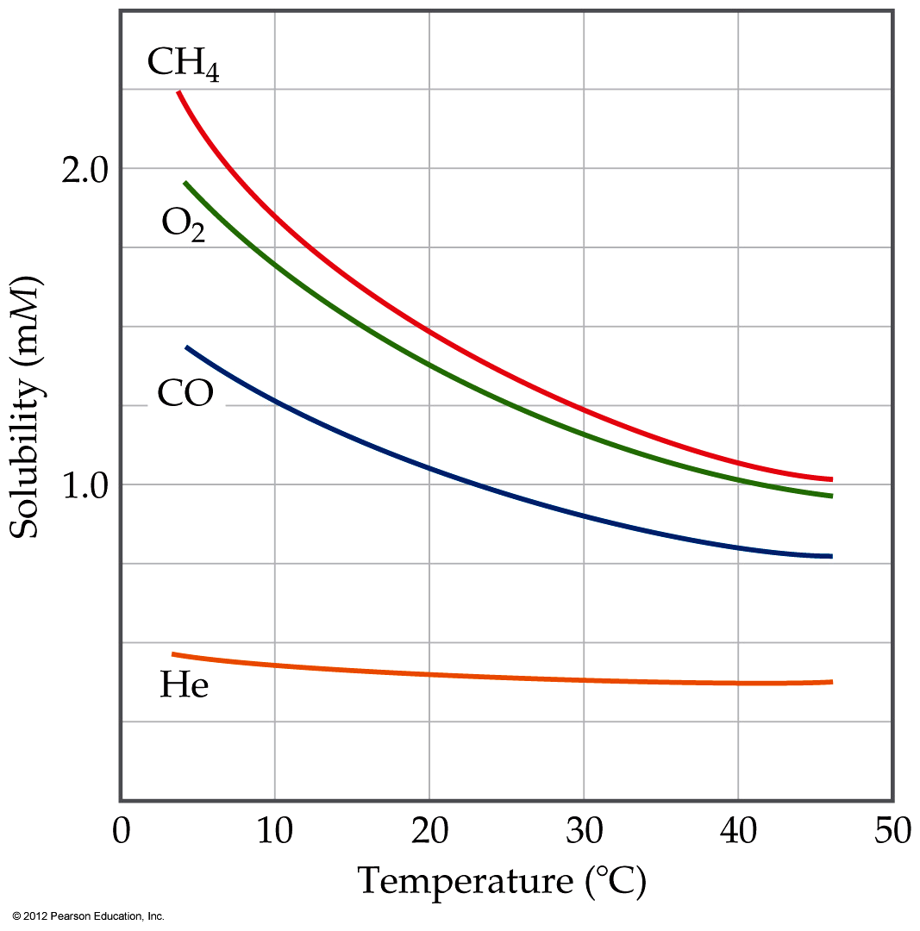
Temperature
The opposite is true of gases.
  Carbonated soft drinks are more “bubbly” if stored in the refrigerator.
  Warm lakes have less O₂ dissolved in them than cool lakes.

Slide 33
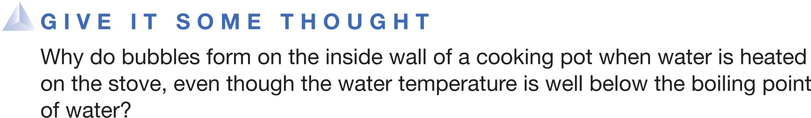
A. Some water molecules break down into gases as water is heated.
B. Dissolved gases are less soluble in solution as temperature increases.
C. Water molecules begin to enter the gas phase to stimulate boiling.
D. Boiling actually begins on a small scale at temperatures below the boiling point.
Notes:
Answer: B

Slide 34
Ways of Expressing Concentrations of Solutions
浓度

Slide 35
Mass Percentage
Ways of Expressing Concentrations of Solutions
质量百分比
mass of A in solution
total mass of solution
Mass % of A =
× 100

Slide 36
Ways of Expressing Concentrations of Solutions
Parts per Million and Parts per Billion
Parts per million (ppm)
mass of A in solution
total mass of solution
ppm =
× 10⁶
Parts per billion (ppb)
mass of A in solution
total mass of solution
ppb =
× 10⁹

Slide 37
Ways of Expressing Concentrations of Solutions
Mole Fraction (X)
摩尔分数
moles of A
total moles of all components
X_{A} =
In some applications, one needs the mole fraction of solvent, not solute—make sure you find the quantity you need!

Slide 38
Ways of Expressing Concentrations of Solutions
Molarity (M)
摩尔浓度
moles of solute
liters of solution
M =
You will recall this concentration measure from Chapter 4.
Since volume is temperature-dependent, molarity can change with temperature.

Slide 39
Ways of Expressing Concentrations of Solutions
Molality (m)
重量克分子浓度
moles of solute
kilograms of solvent
m =
Since both moles and mass do not change with temperature, molality (unlike molarity) is not temperature-dependent.

Slide 40
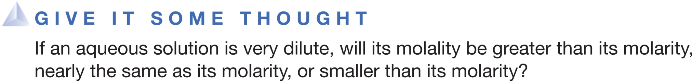
Molality will be greater than its molarity.
Molality will be nearly the same as its molarity.
Molality will be smaller than its molarity.
Notes:
Answer: B

Slide 41
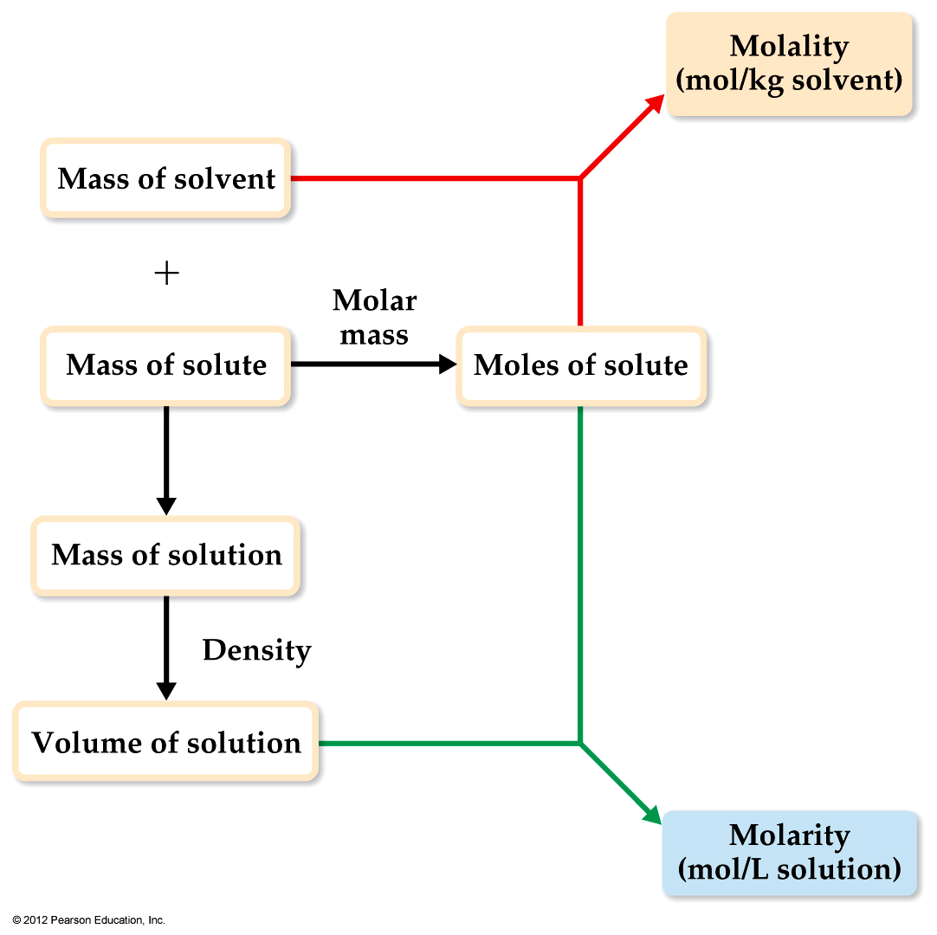
Changing Molarity to Molality
If we know the density of the solution, we can calculate the molality from the molarity, and vice versa.

Slide 42
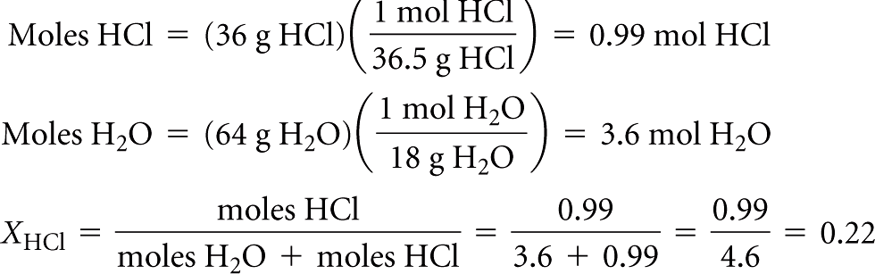

Sample Calculation of Mole Fraction and Molality
An aqueous solution of hydrochloric acid contains 36% HCl by mass.
(a) Calculate the mole fraction of HCl in the solution.
(b) Calculate the molality of HCl in the solution.
Solution
Solve
(a) To calculate the mole fraction of HCl, we convert the masses of HCl and H₂O to moles and then use Equation 13.7:
Plan Let’s assume that there is exactly 100 g of solution. Because the solution is 36% HCl, it contains 36 g of HCl and (100 – 36) g = 64 g of H₂O.
(b) We calculated the number of moles of HCl in part (a), and the mass of solvent is
64 g = 0.064 kg:

Slide 43


Exercise Calculation of Molarity Using the Density of the Solution
A solution with a density of 0.876 g/mL contains 5.0 g of toluene (C₇H₈) and 225 g of benzene. Calculate the
molarity of the solution.
Solution
Analyze Our goal is to calculate the molarity of a solution, given the masses of solute (5.0 g) and solvent (225 g) and the density of the solution (0.876 g/mL).
Solve The number of moles of solute is
The density of the solution is used to convert the mass of the solution to its volume:
Molarity is moles of solute per liter of solution:
Plan The volume of the solution is obtained from the mass of the solution (mass of solute + mass of solvent = 5.0 g + 225 g = 230 g) and its density.

Slide 44
Colligative Properties
依数性
Changes in colligative properties depend only on the number of solute particles present, not on the identity of the solute particles.
Among colligative properties are
  Vapor-pressure lowering
  Boiling-point elevation
  Melting-point depression
  Osmotic pressure

Slide 45
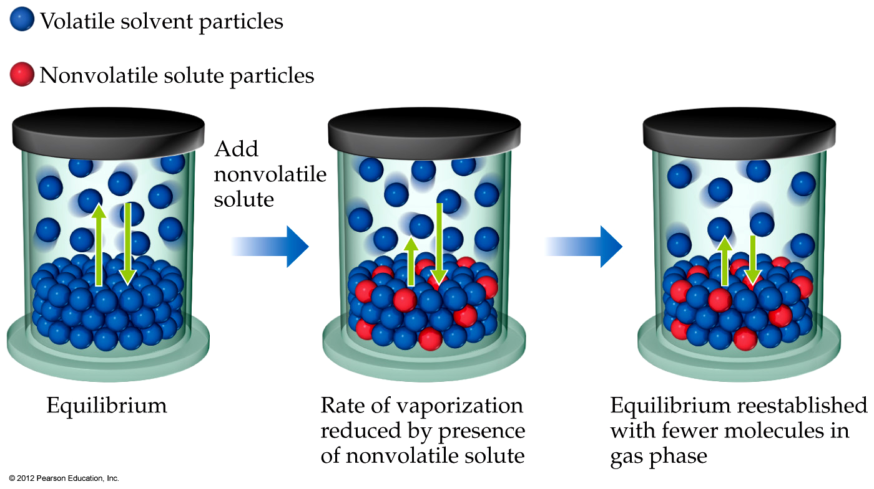
Vapor Pressure
Because of solute–solvent intermolecular attraction, higher concentrations of nonvolatile solutes make it harder for solvent to escape to the vapor phase.

Slide 46
Vapor Pressure
Therefore, the vapor pressure of a solution is lower than that of the pure solvent.

Slide 47
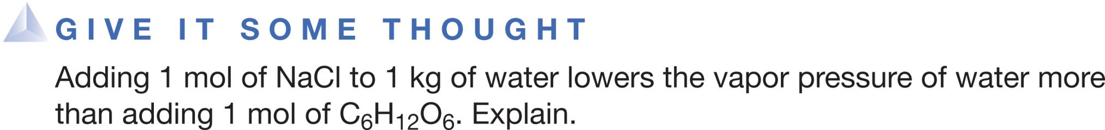
NaCl is highly polar whereas C₆H₁₂O₆ is weakly polar and this causes the difference.
NaCl has a smaller molar mass than that of C₆H₁₂O₆ and this causes the difference.
NaCl is polar whereas C₆H₁₂O₆ is nonpolar and this causes the difference.
The total solute concentration of NaCl is twice that of C₆H₁₂O₆ because NaCl forms Na⁺ and Cl⁻ ions and this causes the difference.
Notes:
Answer: D

Slide 48
Raoult’s Law
P_{A} = X_{A}P°_{A}
where
  X_{A} is the mole fraction of compound A, and
  P°_{A} is the normal vapor pressure of A at that temperature.
  Note: This is one of those times when you want to make sure you have the vapor pressure of the solvent.

Slide 49
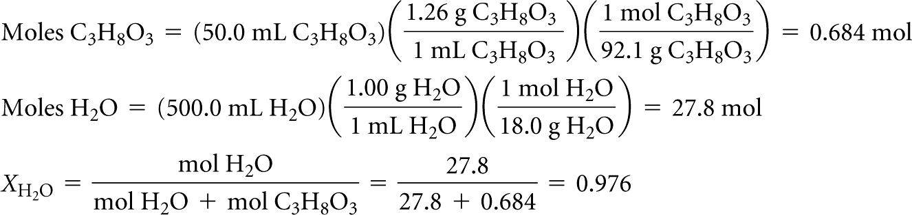
Exercise Calculation of Vapor Pressure of a Solution
Glycerin (C₃H₈O₃) is a nonvolatile nonelectrolyte with a density of 1.26 g/mL at 25 °C. Calculate the vapor pressure at 25 °C of a solution made by adding 50.0 mL of glycerin to 500.0 mL of water. The vapor pressure of
pure water at 25 °C is 23.8 torr (Appendix B), and its density is 1.00 g/mL.
Solution
Analyze Our goal is to calculate the vapor pressure of a solution, given the volumes of solute and solvent and the density of
the solute.
Solve To calculate the mole fraction of water in the solution, we must determine the number of moles of C₃H₈O₃ and H₂O:
We now use Raoult’s law to calculate the vapor pressure of water for the solution:
Plan The mole fraction of the solvent in the solution, X_{solvent}, is the ratio of the number of moles of solvent (H₂O) to total moles of solution (moles C₃H₈O₃ + moles H₂O).

Slide 50

Vapor Pressure of a Mixture: Raoult's Law

Slide 51
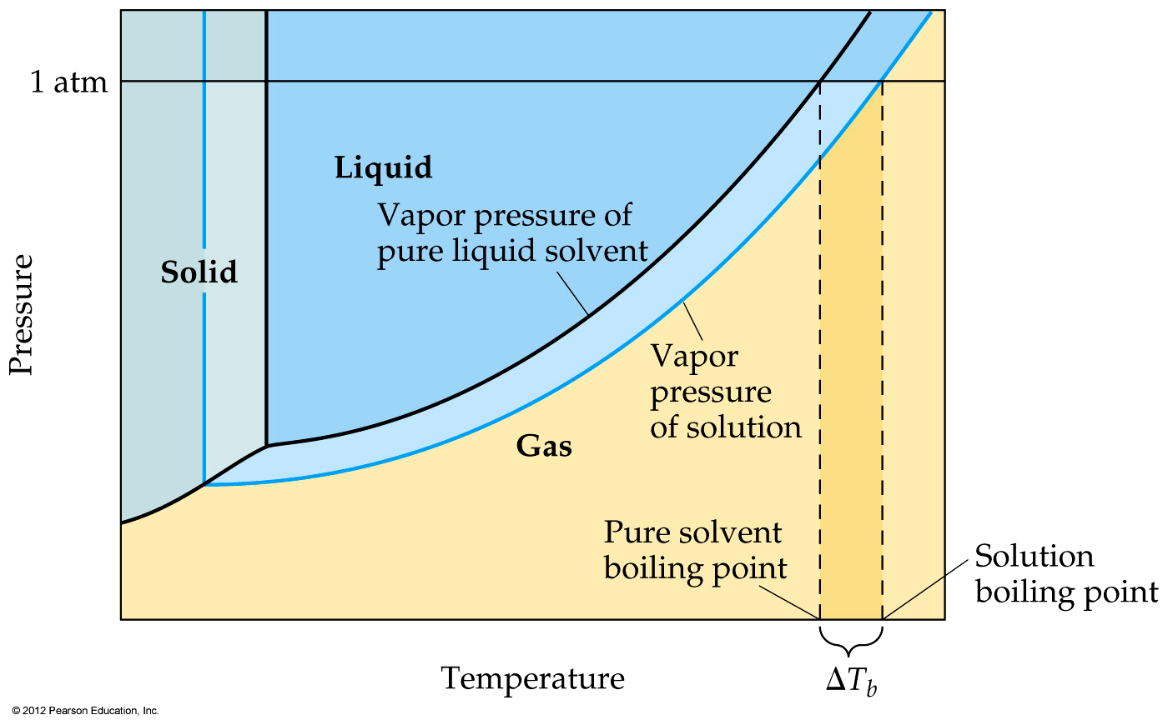
Boiling-Point Elevation and
Freezing-Point Depression
Nonvolatile solute–solvent interactions also cause solutions to have higher boiling points and lower freezing points than the pure solvent.

Slide 52
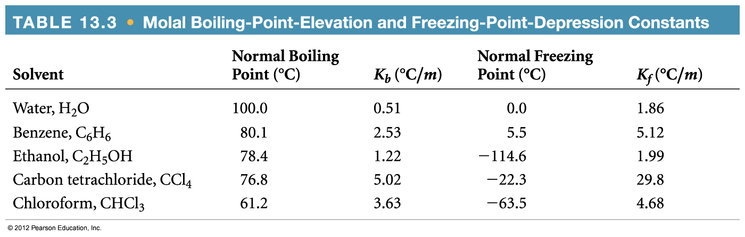
Boiling-Point Elevation
The change in boiling point is proportional to the molality of the solution:
ΔT_{b} = K_{b} • m
where K_{b} is the molal boiling-point elevation constant, a property of the solvent.
ΔT_{b} is added to the normal boiling point of the solvent.

Slide 53
Freezing-Point Depression
The change in freezing point can be found similarly:
ΔT_{f} = K_{f} • m
Here K_{f} is the molal freezing-point depression constant of the solvent.
ΔT_{f} is subtracted from the normal freezing point of the solvent.

Slide 54
Boiling-Point Elevation and
Freezing-Point Depression
Note that in both equations, ΔT does not depend on what the solute is, but only on how many particles are dissolved.
ΔT_{b} = K_{b} • m
ΔT_{f} = K_{f} • m
Notes:
Start here 1/26/10--10 AM

Slide 55
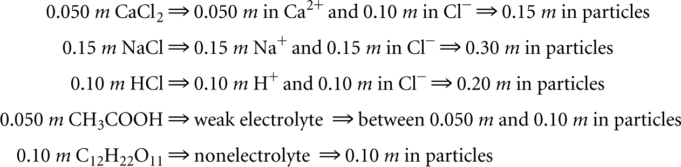
Exercise Freezing-Point Depression in Aqueous Solutions
List the following aqueous solutions in order of their expected freezing point: 0.050 m CaCl₂, 0.15 m NaCl, 0.10 m HCl, 0.050 m CH₃COOH, 0.10 m C₁₂H₂₂O₁₁.
Solution
Solve CaCl₂, NaCl, and HCl are strong electrolytes, CH₃COOH (acetic acid) is a weak electrolyte, and C₁₂H₂₂O₁₁ is a nonelectrolyte. The molality of each solution in total particles is as follows:
Because the freezing points depend on the total molality of particles in solution, the expected ordering is 0.15 m NaCl (lowest freezing point), 0.10 m HCl, 0.050 m CaCl₂, 0.10 m C₁₂H₂₂O₁₁, and 0.050 m CH₃COOH (highest freezing point).

Slide 56
Colligative Properties of Electrolytes
电解质
Since the colligative properties of electrolytes depend on the number of particles dissolved, solutions of electrolytes (which dissociate in solution) should show greater changes than those of nonelectrolytes.

Slide 57
Colligative Properties of Electrolytes
However, a 1M solution of NaCl does not show twice the change in freezing point that a 1M solution of methanol does.

Slide 58
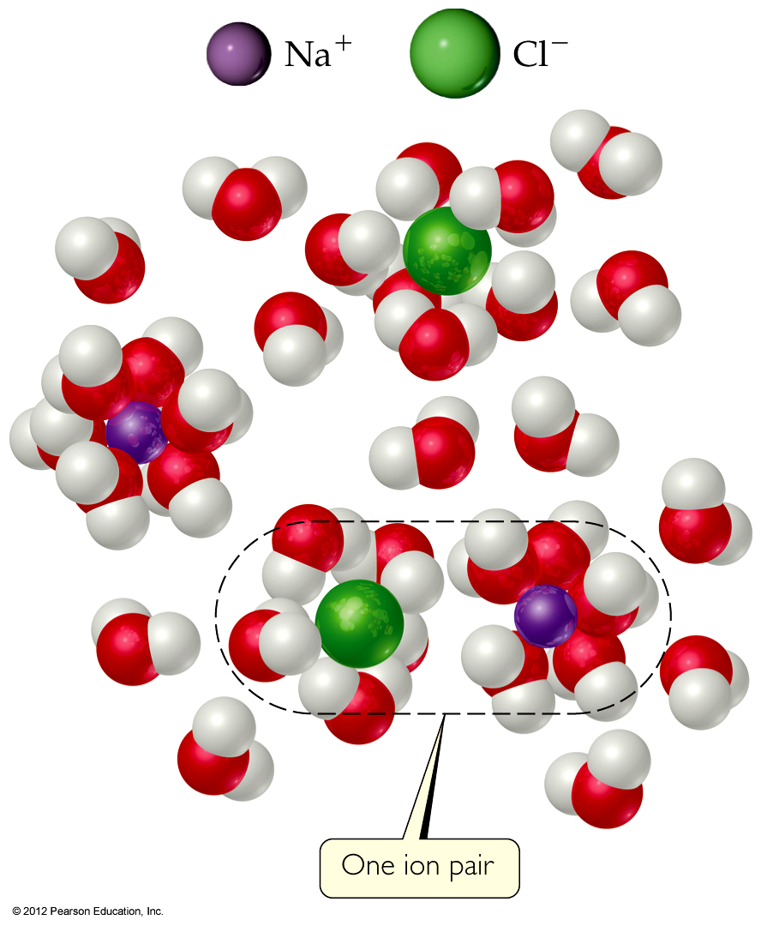
van’t Hoff Factor
One mole of NaCl in water does not really give rise to two moles of ions.

Slide 59
van’t Hoff Factor
Some Na⁺ and Cl⁻ reassociate for a short time, so the true concentration of particles is somewhat less than two times the concentration of NaCl.

Slide 60
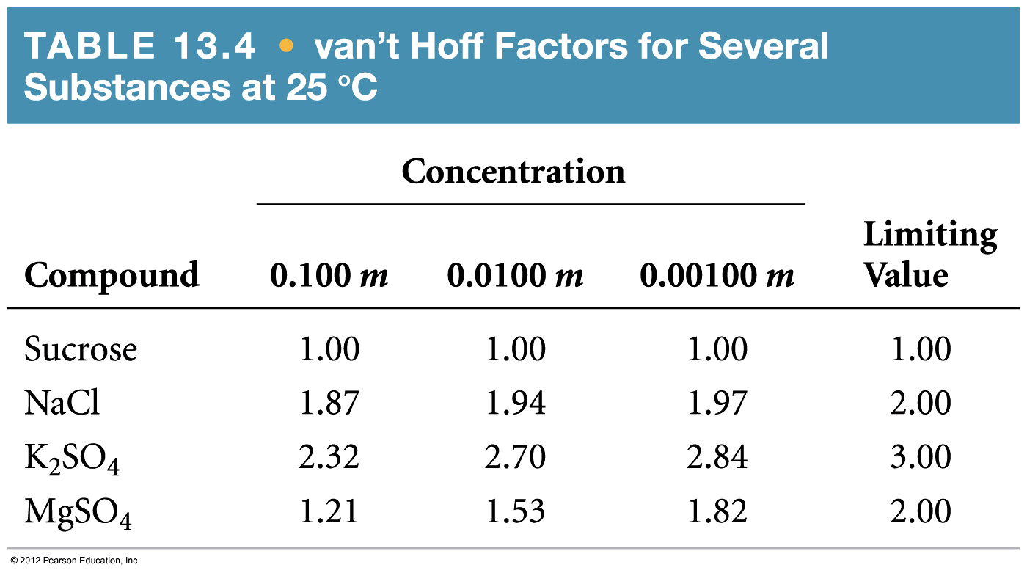
van’t Hoff Factor
Re-association is more likely at higher concentration.
Therefore, the number of particles present is concentration-dependent.

Slide 61
van’t Hoff Factor
We modify the previous equations by multiplying by the van’t Hoff factor, i:
ΔT_{f} = K_{f} • m • i

Slide 62
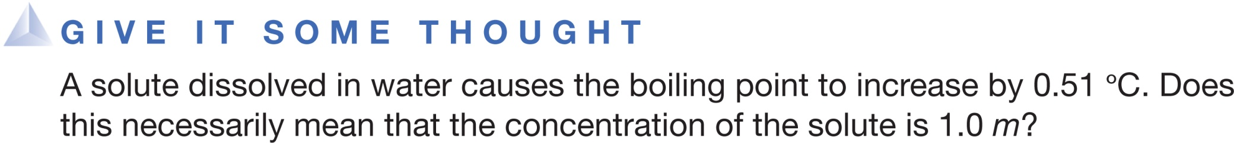
Yes
No
Depends on whether the solute is a strong or weak electrolyte
Depends on if the solute is a nonpolar, nonelectrolyte
ΔT_{b} = K_{b} • m
Notes:
Answer: C

Slide 63
Osmosis
渗透
Some substances form semipermeable membranes, allowing some smaller particles to pass through, but blocking other larger particles.
In biological systems, most semipermeable membranes allow water to pass through, but solutes are not free to do so.

Slide 64
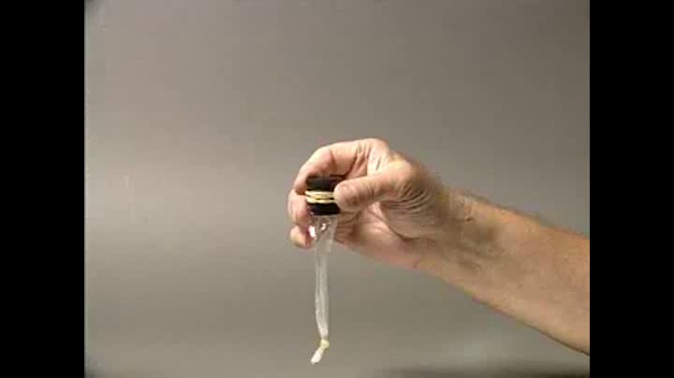
Osmosis

Slide 65
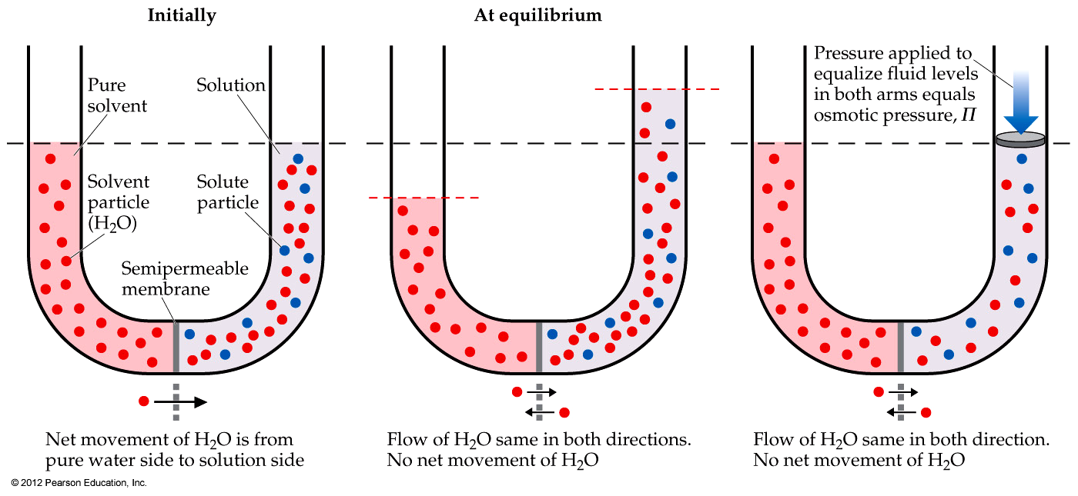
Osmosis
In osmosis, there is net movement of solvent from the area of higher solvent concentration (lower solute concentration) to the area of lower solvent concentration (higher solute concentration).

Slide 66
Osmotic Pressure
The pressure required to stop osmosis, known as osmotic pressure, Π, is
n
V
Π = ( )RT = MRT
where M is the molarity of the solution and R is ideal-gas constant.
If the osmotic pressure is the same on both sides of a membrane (i.e., the concentrations are the same), the solutions are isotonic.
等渗的

Slide 67
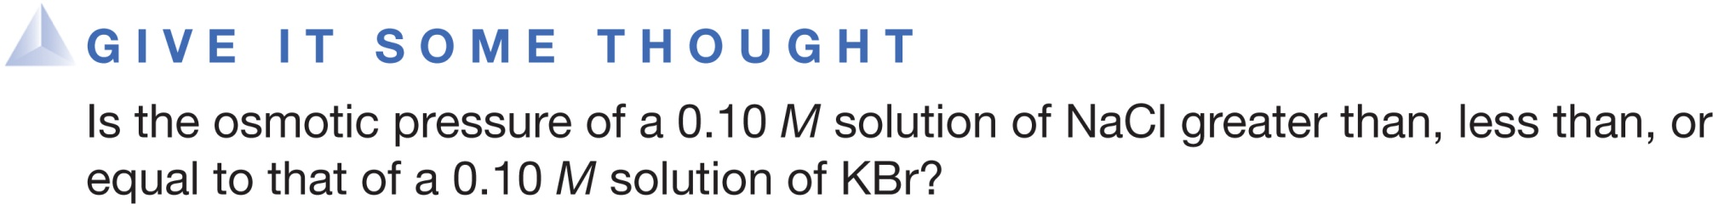
The osmotic pressure of a 0.10 M solution of NaCl is greater than that of a 0.10 M solution
of KBr.
The osmotic pressure of a 0.10 M solution of NaCl is equal to that of a 0.10 M solution of KBr.
The osmotic pressure of a 0.10 M solution of NaCl is less than than that of a 0.10 M solution of KBr.
Notes:
Answer: B

Slide 68
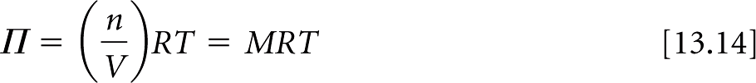
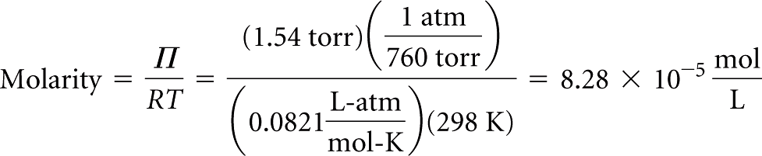
Exercise Molar Mass from Osmotic Pressure
The osmotic pressure of an aqueous solution of a certain protein was measured to determine the protein’s molar mass. The solution contained 3.50 mg of protein dissolved in sufficient water to form 5.00 mL of solution. The osmotic pressure of the solution at 25 °C was found to be 1.54 torr. Treating the protein as a nonelectrolyte, calculate its molar mass.
Solution
Plan The temperature (T = 25 °C) and osmotic pressure (Π = 1.54 torr) are given, and we know the value of R so we can use Equation 13.14 to calculate the molarity of the solution, M. In doing so, we must convert temperature from °C to K and the osmotic pressure from torr to atm. We then use the molarity and the volume of the solution (5.00 mL) to determine the number of moles of solute. Finally, we obtain the molar mass by dividing the mass of the solute (3.50 mg) by the number of moles of solute.
Solve Solving Equation 13.14 for molarity gives

Slide 69
Exercise Molar Mass from Osmotic Pressure
Because the volume of the solution is 5.00 mL = 5.00 × 10⁻³ L, the number of moles of protein must be
The molar mass is the number of grams per mole of the substance. The sample has a mass of 3.50 mg = 3.50 × 10⁻³ g. The molar mass is the number of grams divided by the number of moles:
Comment Because small pressures can be measured easily and accurately, osmotic pressure measurements provide a useful way to determine the molar masses of large molecules (including proteins and man-made polymers).

Slide 70
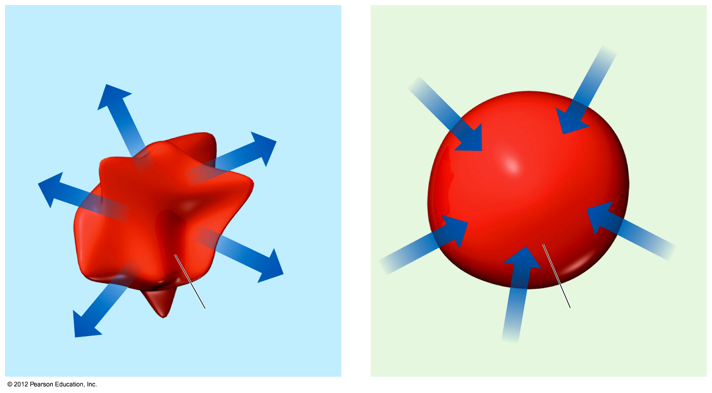
Osmosis in Blood Cells
High solute
concentration
The blue arrows represent the net movement of water molecules.
If the solute concentration outside the cell is greater than that inside the cell, the solution is hypertonic.
Water will flow out of the cell, and crenation results.
高渗的
皱缩
Low solute
concentration
The average osmotic pressure of blood is 7.7 atm at 25 °C.

Slide 71
Osmosis in Cells
Low solute
concentration
The blue arrows represent the net movement of water molecules.
If the solute concentration outside the cell is less than that inside the cell, the solution is hypotonic.
Water will flow into the cell, and hemolysis results.
低渗的
溶血
Low solute
concentration
The average osmotic pressure of blood is 7.7 atm at 25 °C.

Slide 72
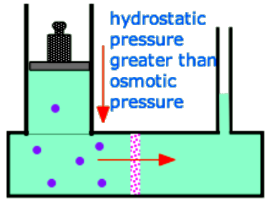
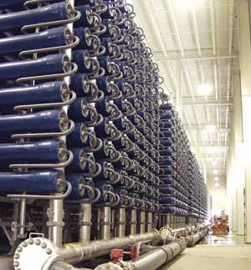
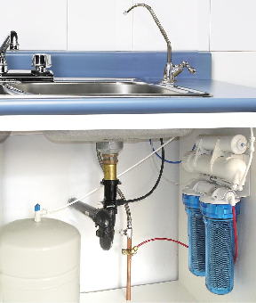
Reverse Osmosis
Applying a hydrostatic pressure greater than this to the high-solute side of an osmotic cell will force water to flow back into the fresh-water side. This process is now the major technology employed to desalinate ocean water and to reclaim "used" water from power plants, runoff, and even from sewage.

Slide 73
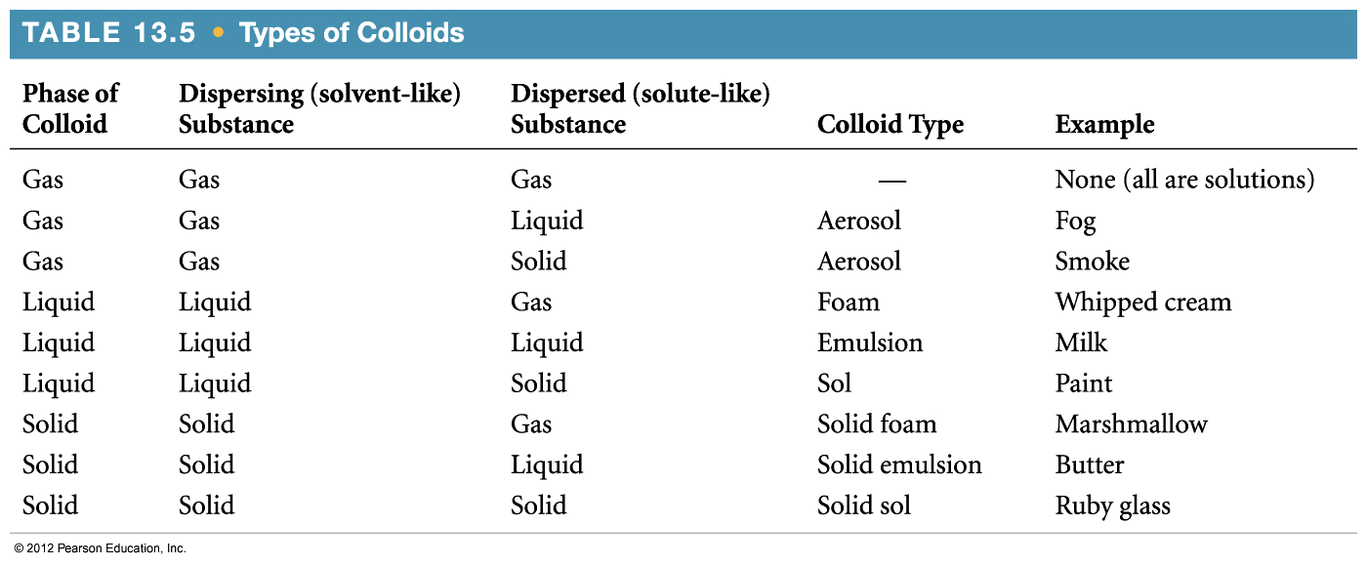
Colloids
胶体
Suspensions of particles larger than individual ions or molecules, but too small to be settled out by gravity, are called colloids.

Slide 74
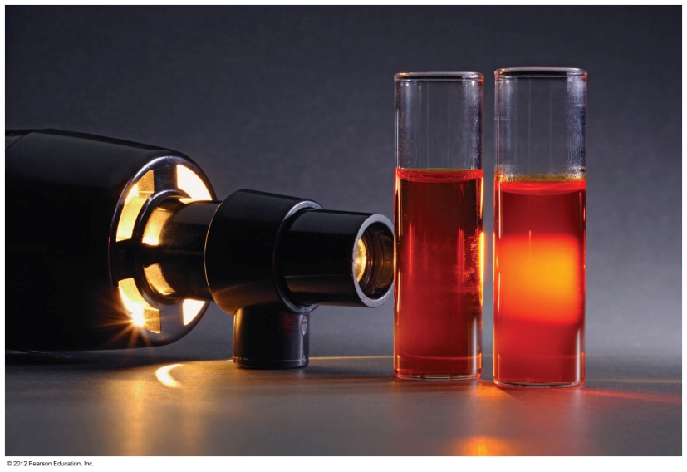

Tyndall Effect
Colloidal suspensions can scatter rays of light.
This phenomenon is known as the Tyndall effect.

Slide 75
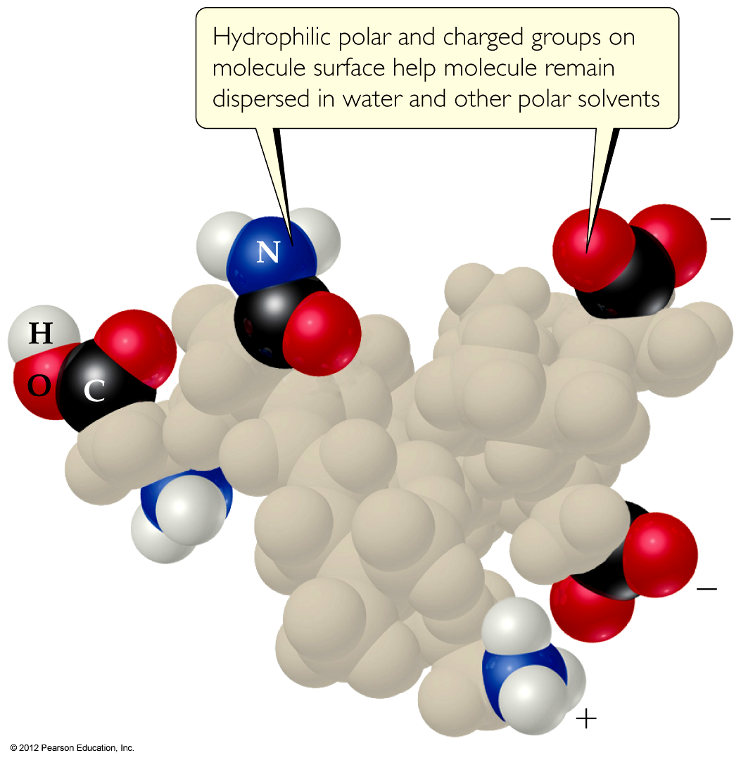
Colloids in Biological Systems
Some molecules have a polar, hydrophilic (water-loving) end and a nonpolar, hydrophobic (water-hating) end.

Slide 76
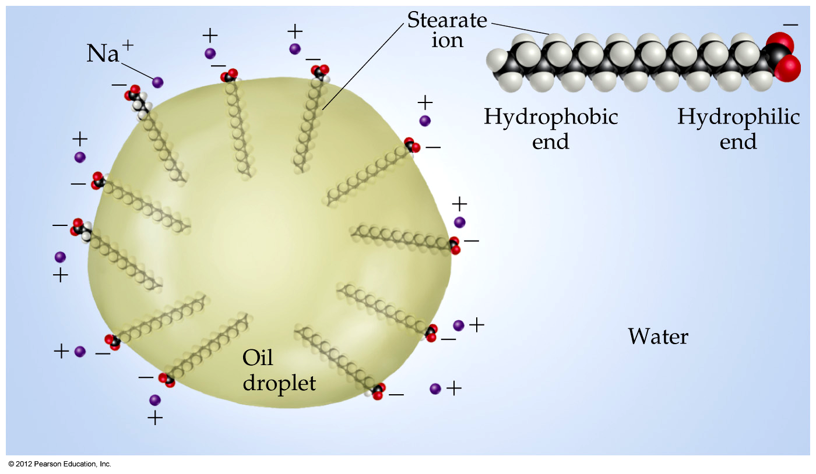
Colloids in Biological Systems
These molecules can aid in the emulsification of fats and oils in aqueous solutions.
乳化

Slide 77
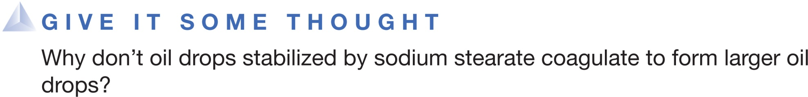
A. The stearate ion helps the oil droplets bind to the container walls.
B. The smaller droplets are separated from one another by stearate micelles.
C. The smaller droplets carry negative charges because of the embedded stearate ions and thus repel one another.
D. The sodium stearate causes the oil particles to decompose very slowly.
Notes:
Answer: C

Slide 78
The rule of “like dissolves like” refers to similarities between _______ of miscible liquids.
molecular weights
shapes
intermolecular attractive forces
d. densities
Notes:
Answer: c

Slide 79
Which of the following compounds is miscible with water?
CH₃OH
CH₄
C₆H₆
d. CH₃CH₂OCH₂CH₃
Notes:
Answer: a

Slide 80
Which of the compounds below is the LEAST miscible with water?
CH₃OH
CH₃CH₂OH
CH₃CH₂CH₂OH
d. CH₃CH₂CH₂CH₂OH
Notes:
Answer: d

Slide 81
_______ Law says that the solubility of a gas in a liquid increases as the pressure of the gas increases.
Boyle’s
Charles’s
Henry’s
d. Raoult’s
Notes:
Answer: c

Slide 82
_______ Law says that the vapor pressure of a solution is proportional to the mole fraction of the solvent.
Boyle’s
Charles’s
Henry’s
d. Raoult’s
Notes:
Answer: d

Slide 83
The molality of a solution is defined as the amount of solute (in moles) divided by the
volume of the solution (in liters).
mass of the solvent (in kilograms).
mass of the solution (in kilograms).
d. total number of moles.
Notes:
Answer: b

Slide 84
In general, as the temperature of a solution increases, the solubility of a gaseous solute
increases.
decreases.
remains unchanged.
d. varies from gas to gas.
Notes:
Answer: b

Slide 85
What is the freezing point of a 2.00 m aqueous solution of sucrose? The value of K_{f} for water is 1.86 degrees C/molal.
–3.72 degrees C
–1.86 degrees C
+1.86 degrees C
d. +3.72 degrees C
Notes:
Answer: a

Slide 86
What is the vapor pressure of a solution containing 0.500 mol of glucose and 5.000 mol of water at 29 degrees C?
30.0 Torr
27.3 Torr
25.0 Torr
d. 2.7 Torr
Notes:
Answer: b

Slide 87
A 0.100 molal solution of which compound below will have the lowest freezing point?
NaCl
CaCl₂
KI
d. LiNO₃
Notes:
Answer: b

Slide 88
Two solutions that are isotonic have the same
density.
volume.
vapor pressure.
d. osmotic pressure.
Notes:
Answer: d

Slide 89
At 298 K, 25.00 mL of solution containing 27.55 mg of protein has an osmotic pressure of 3.22 Torr. The molecular weight of the protein is
2,340,000. b. 159,000.
c. 6360. d. 254.
Notes:
Answer: c

Slide 90
What is the molecular weight of adrenaline if 0.64 grams of adrenaline dissolved in 36.0 g of CCl₄ raises the boiling point by 0.49 degrees Celsius?
180 g/mole b. 360 g/mole
c. 720 g/mole d. 1800 g/mole
Notes:
Answer: a

Slide 91
Which substance below is NOT a colloid?
Butter
Smoke
Whipped cream
d. Salt water
Notes:
Answer: d

Slide 92
Light scattering by colloidally dispersed particles is an example of the _______ effect.
Tyndall
Raoult
Hall
d. Meissner
Notes:
Answer: a

